Slide 1
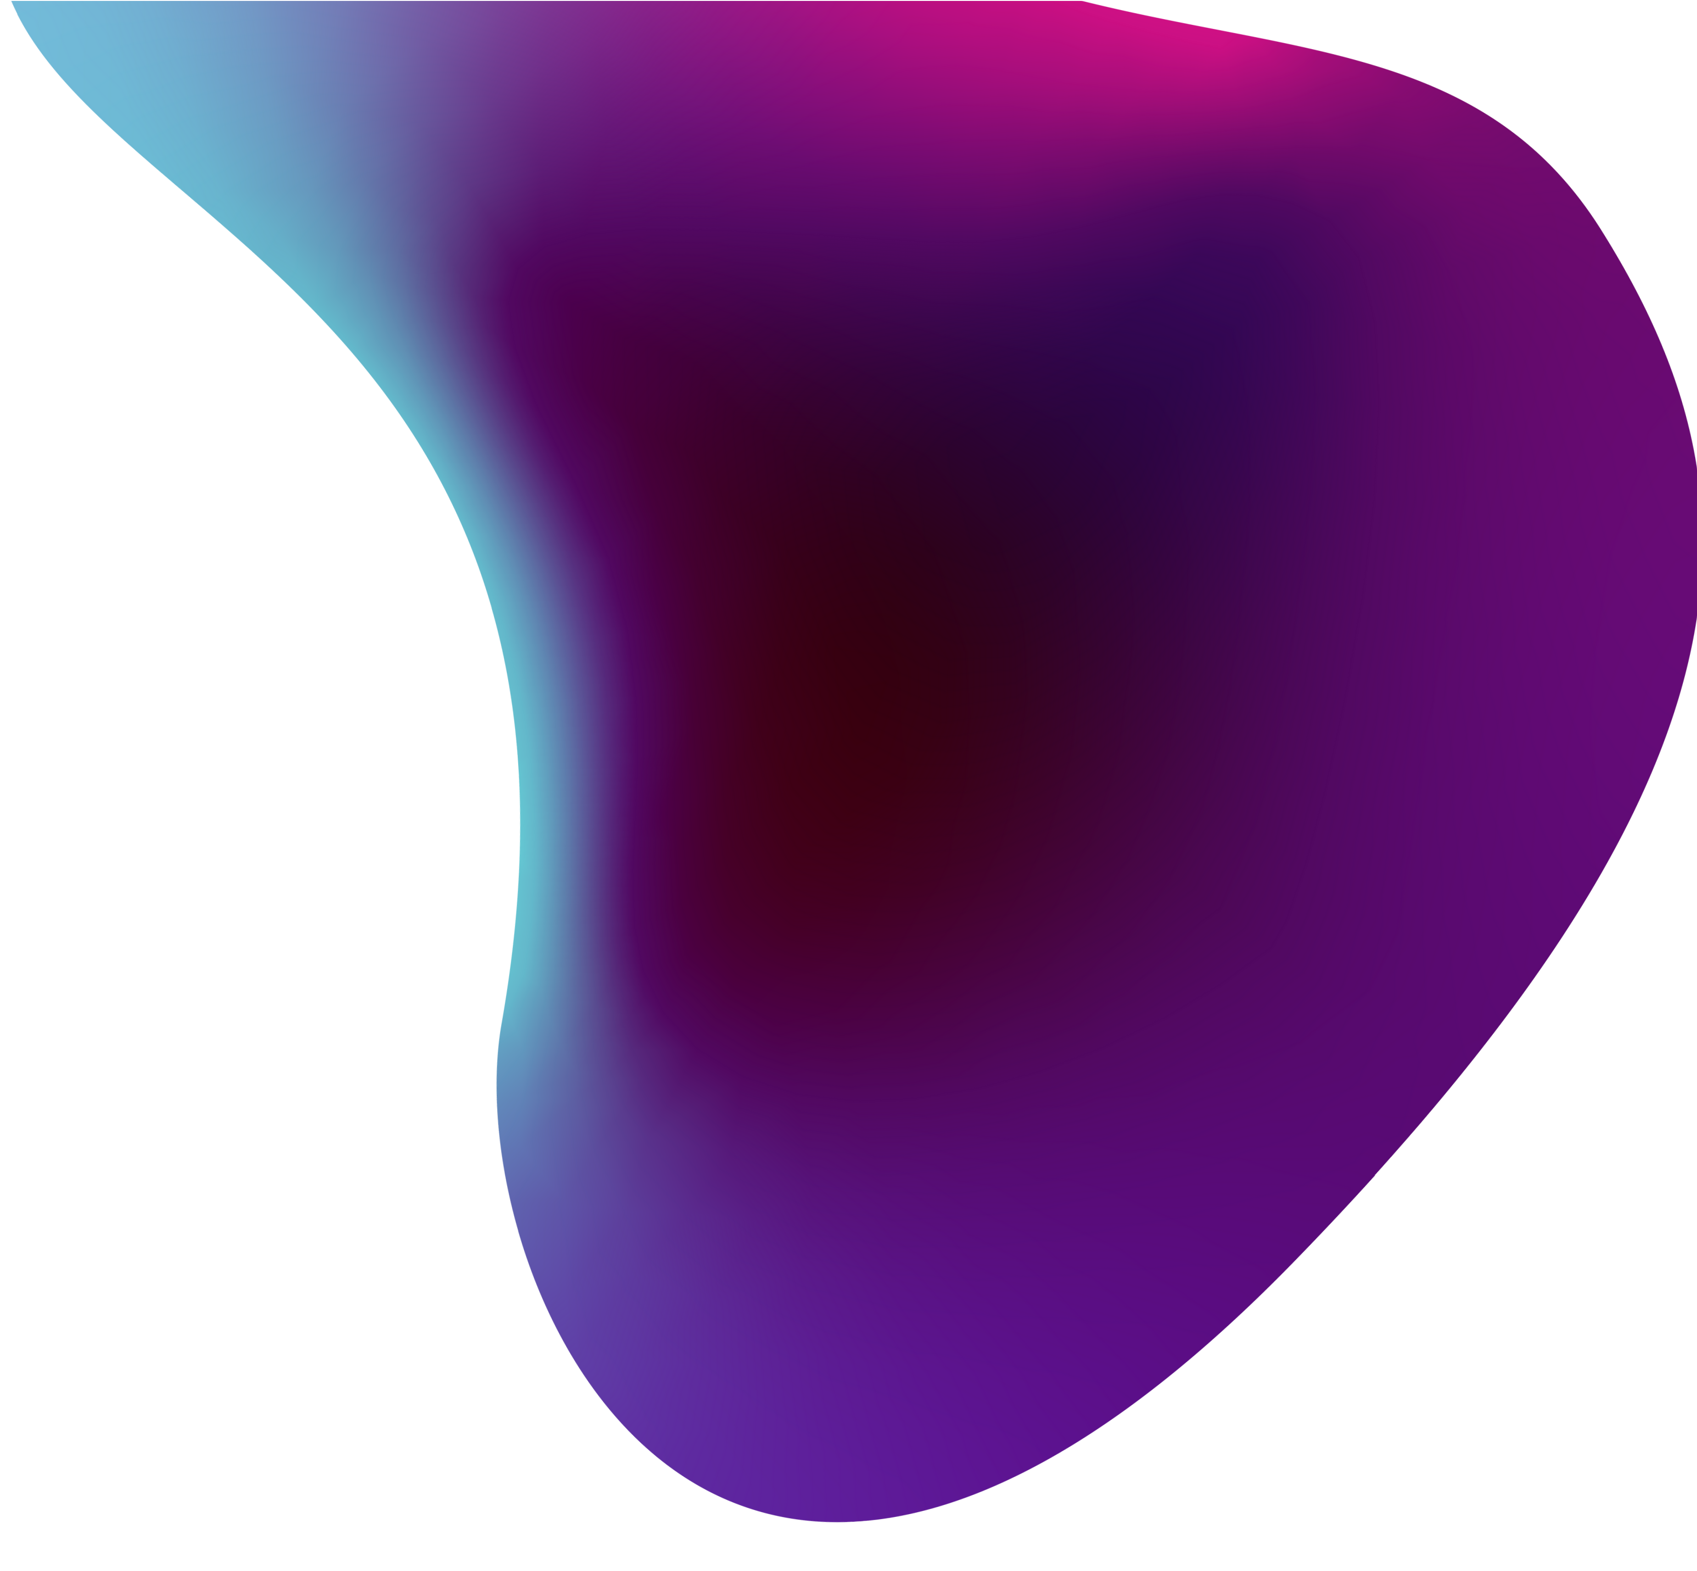


Internal Assessment
Honours: Data Analytics
16010122156 - Ronak Rathod
16010122154 - Vedant Rathi
16010122141 - Yuvraj Patil
16010122151 - Hyder Presswala

Slide 2



A Comprehensive Survey on Machine Learning- Based Big Data Analytics for IoT-Enabled Smart Healthcare System
Article written by: Wei Li, Yuanbo Chai, Fazlullah Khan, Syed Rooh Ullah Jan, Sahil Verma, & Varun G. Menon, Kavita, Xingwang Li
Reference Link: https://link.springer.com/article/10.1007/s11036-020-01700-6

Slide 3


Abstract
The COVID-19 pandemic has underscored the need for improved healthcare solutions globally, beyond traditional hospitals and clinics. Smart wearables, empowered by IoT technology, offer a promising avenue for collecting extensive data on physical, behavioral, and psychological health. However, managing the vast volumes of data generated by these devices poses challenges for decision-making centers. This paper discusses the emerging applications of machine learning and big data analytics in IoT healthcare, emphasizing the lack of dedicated research in this area. It reviews existing techniques, highlights their strengths and weaknesses, and identifies research challenges. The study aims to inform healthcare practitioners and government agencies about the evolving trends in ML-based big data analytics for smarter healthcare solutions.

Slide 4


Introduction
In recent years, Wireless Sensor Networks (WSNs) have fueled the growth of the Internet of Things (IoT). IoT, conceptualized by Kevin Ashton in 1999, connects objects to the internet, transforming various aspects of our lives. This technology has profoundly impacted various aspects of our daily lives, including smart healthcare, smart cities, smart agriculture, crowd sensing, and more. Yet, this advancement poses challenges, including managing vast IoT-generated data. Machine Learning (ML) is pivotal in addressing these challenges, with an estimated annual economic impact of $5.2 trillion to $6.7 trillion by 2025. This research endeavors to delve into the intersection of big data and IoT, with a specific focus on IoT eHealth. Surprisingly, the literature on big data analytics and ML techniques in IoT healthcare is scarce.

Slide 5
Introduction
This research endeavors to delve into the intersection of big data and IoT, with a specific focus on IoT eHealth. Surprisingly, the literature on big data analytics and ML techniques in IoT healthcare is scarce. Thus, our primary objective is to present the developments in ML and big data analytics tailored for IoT eHealth. We also aim to highlight the strengths, weaknesses, and future challenges in this domain. This comprehensive survey fills a critical gap and equips readers with insights to choose the most suitable tools and techniques for healthcare data analytics in the IoT era. The paper's contributions include discussing the relationship between big data and IoT, examining big data challenges in IoT healthcare, reviewing ML techniques for healthcare data analysis, and identifying research challenges in this field.

Slide 6
Structure of the Paper

Slide 7




The Internet of Things
The Internet of Things (IoT) is a network of interconnected smart objects equipped with sensors that communicate through the internet. It has been facilitated by technologies like wireless communication and micro-electro-mechanical systems (MEMS). Market analysts predict that by 2020, approximately 25 billion sensor-enabled devices will be deployed, with a projected market value of around $2.1 trillion by 2025. IoT applications span various sectors, including smart cities, energy management, agriculture, military, environmental monitoring, and healthcare. In the healthcare sector alone, IoT is expected to have a significant economic impact, estimated at $176.82 billion by 2026, though challenges such as big data analytics will need to be addressed for its continued growth.

Slide 8



IoT in Health Care
The healthcare sector has witnessed a surge in technology integration, particularly in eHealth and mHealth, with millions of sensors continuously monitoring patients' health. Wireless Body Sensor Networks (WBSN) play a key role, featuring layers like sensing, communication, processing, storage, and mining/learning. Sensors, including advanced Medical Super Sensors (MSS), collect vital health data. The communication layer employs various protocols like Bluetooth and ZigBee, facing challenges in network management, QoS, security, and data aggregation. The processing layer analyzes data with limited hardware capabilities, and the storage layer manages vast data through cloud-based platforms. Lastly, the mining and learning layer utilizes machine learning for big data analytics in healthcare IoT, extracting valuable insights and potentially reshaping healthcare practices.

Slide 9





Big data challenges in IoT smart healthcare
In IoT-based smart healthcare, managing big data is a challenge. Patient-attached sensors and medical devices generate vast, diverse datasets (Big Data).
This data often contains redundant and correlated patterns. Challenges include efficient data processing and transmission across networks.
Energy consumption and bandwidth strain in resource-constrained networks are common issues.
To address these challenges, big data analytics is essential.
It helps aggregate and preprocess raw data before transmission. The goal is to ensure accurate and timely decision-making.
Effective data processing within the network involves error removal and insights extraction.
These techniques enhance performance and conserve energy. They support sustained long-term operations in healthcare IoT.

Slide 10



Machine learning and big data analytics for IoT
Machine Learning (ML) is a subfield of computer science and artificial intelligence that enables machines to learn and make complex decisions without explicit programming. It has found success in various domains like computer vision, natural language processing, and computer networks. ML's significance has grown in IoT and big data analytics due to its ability to handle highly correlated and complex data from IoT devices, resulting in data management challenges. ML plays a crucial role in IoT eHealth by extracting valuable insights from diverse data sources such as sensors and body area networks, enhancing decision- making, and enabling the development of intelligent IoT applications. Despite ML's application in various IoT domains, there is a lack of comprehensive literature reviews exclusively focusing on big data analytics in IoT healthcare. The next section discusses the latest ML techniques for IoT smart healthcare, highlighting strengths, weaknesses, and future challenges for further exploration.

Slide 11





A taxonomy of machine learning techniques for big data analysis in IoT smart healthcare system
IoT aims to enhance human lives by automating tasks and shifting monitoring and decision-making from humans to machines, as seen in assisted living applications where sensors monitor patients' health and medication, improving timeliness and accuracy. This section leverages machine learning techniques in IoT Healthcare:
ML-based recommendation System: Personalized IoT solutions are recommended by analyzing patient data, including health history and demographics. ML techniques like decision trees and logistic regression predict diseases.
ML-Based Prediction System: Early disease detection and monitoring can be done using ML. Stress prediction through heartbeat analysis and Parkinson's detection using speech recognition algorithms.

Slide 12
A taxonomy of machine learning techniques for big data analysis in IoT smart healthcare system
ML-Based Data Aggregation: Real-time data compression, reducing redundant information at sensor levels. Cluster-based frameworks enhance network efficiency, and big data techniques improve data quality.
ML-Based Living Assistance: IoT-based living assistance for the elderly and patients. Continuous monitoring of vital signs, medication intake, and alerts during critical situations.
ML-Based Secured Analysis: Ensuring security and privacy of healthcare data. ML techniques protect sensitive information through watermarking, signal enhancement, and security models. Wireless Body Sensor Networks (WBSN) are secured with ML.

Slide 13
A taxonomy of machine learning techniques for big data analysis in IoT smart healthcare system
Benefits of leveraging ML Techniques in IoT health care:
Enhanced Personalization: ML enables personalized healthcare solutions tailored to individual needs.
Early Disease Detection: ML-based prediction systems aid in the early detection and monitoring of diseases.
Efficient Data Handling: ML-based data aggregation techniques improve network efficiency and data quality.
Improved Patient Care: ML-driven living assistance systems enhance patient care, especially for the elderly.
Enhanced Security : ML ensures the security and privacy of healthcare data.

Slide 14


Challenges and open research issues
There are various challenges related to ML techniques for big data analytics in the IoT healthcare domain:
Resource Scarcity : IoT devices often have limited energy and computational power, leading to challenges in managing correlated data, high energy consumption, and resource constraints. Integrating IoT with cloud computing helps but increases complexity, necessitating novel, energy-efficient data aggregation techniques and resource allocation optimizations.
Security and Privacy : IoT's impact on healthcare is revolutionary, offering personalized access to healthcare services, but it raises significant challenges in security and privacy due to the sensitivity of health-related data, leading to the need for lightweight and energy- efficient data aggregation techniques to ensure confidentiality and security.

Slide 15
Challenges and open research issues
Interoperability : The interoperability
lack of globally accepted standards poses
challenges
in healthcare IoT. Focusing on
interoperability among
IoT eHealth devices, like wearables and
sensors, is crucial. Interoperable devices offer advantages, including increased throughput and reduced maintenance costs. Achieving semantic interoperability for clinical information is essential.
Energy Management and Big Data Analytics: Energy management is critical for energy-constrained IoT healthcare devices. Designing low- power sensors and energy optimization algorithms is essential. Optimizing routing approaches, like data aggregation, can reduce communication costs and conserve energy. Handling large-scale unstructured data in IoT healthcare requires ML and DL techniques, real-time analytics, and innovative noise removal for enhanced data quality and decision-making.

Slide 16



Limitations and future work
In this paper, we conducted a thorough survey of big data analytics in IoT healthcare. We reviewed relevant literature, highlighted research gaps, and presented the latest insights. We also provided an overview of ML- based techniques for big data analytics in this field, discussing their pros and cons, serving as a guide for researchers to explore. We discussed research challenges and the impact of emerging cross-domain IoT architectures, like IoNT and WoT. These insights aim to inspire further research. Our ultimate vision is to see IoT technology seamlessly integrated across domains, enriching our daily lives in the future.

Slide 17
Dataset
https://drive.google.com/drive/u/2/folders/17x7Pvn-VatN-pHbThauUwY5CpmVaYe5e
Our research paper didn’t have DataSet so we have taken similar DataSet

Slide 18
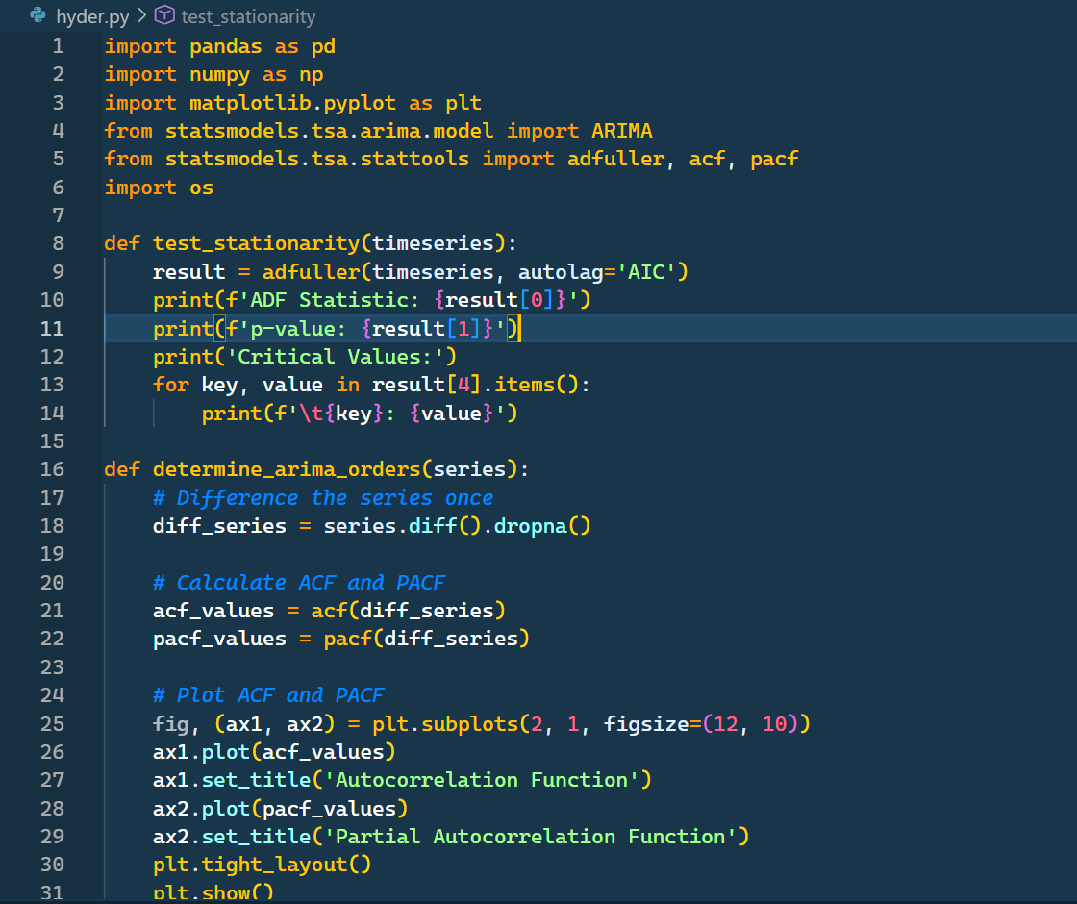
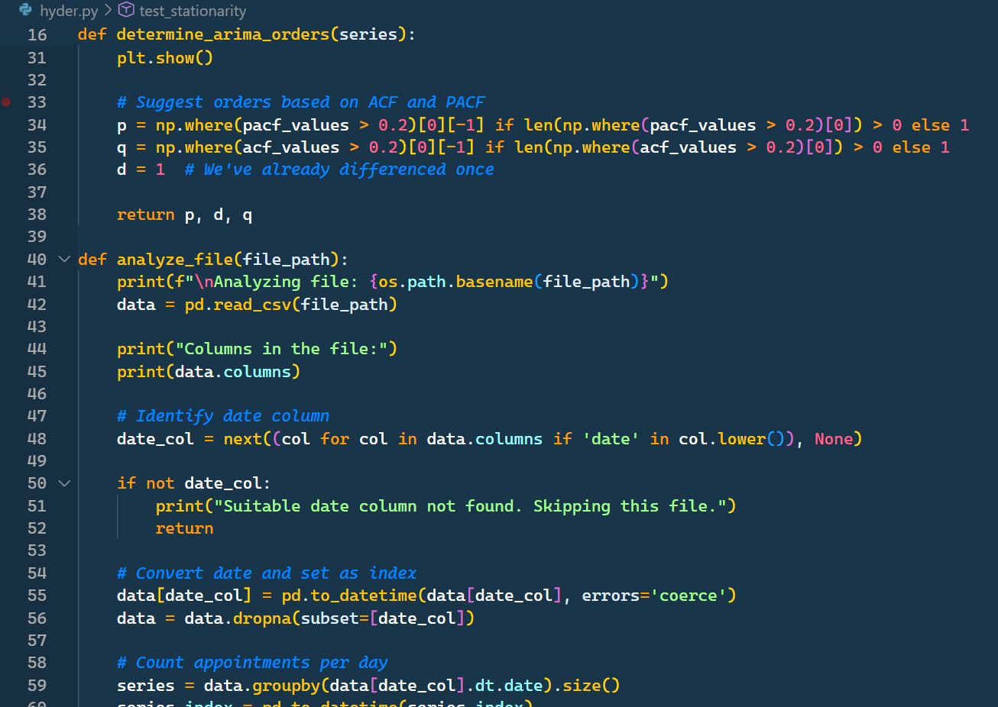
Code

Slide 19
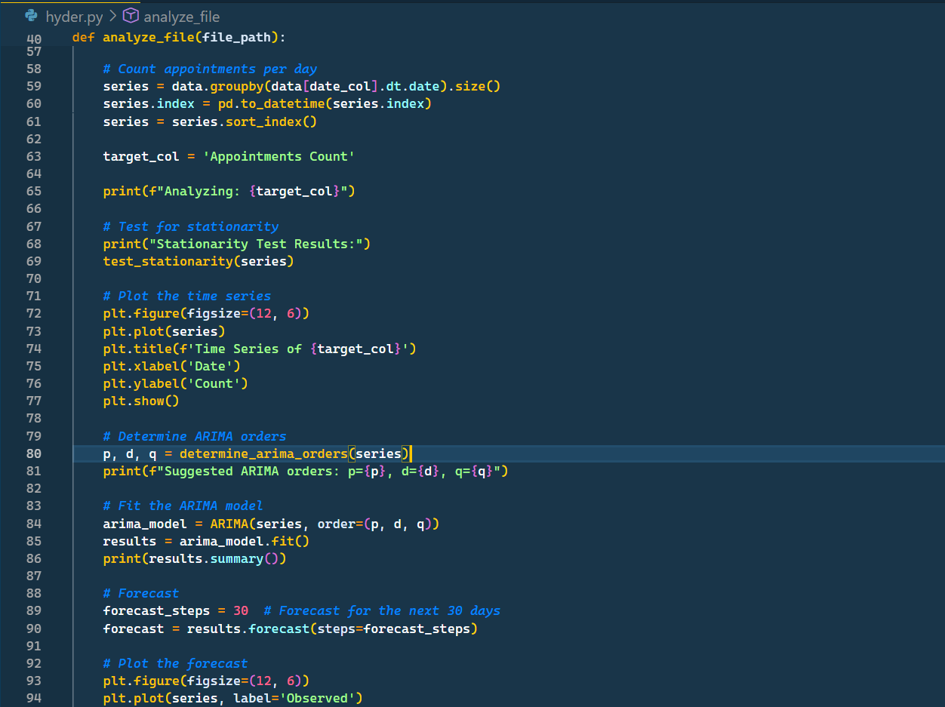
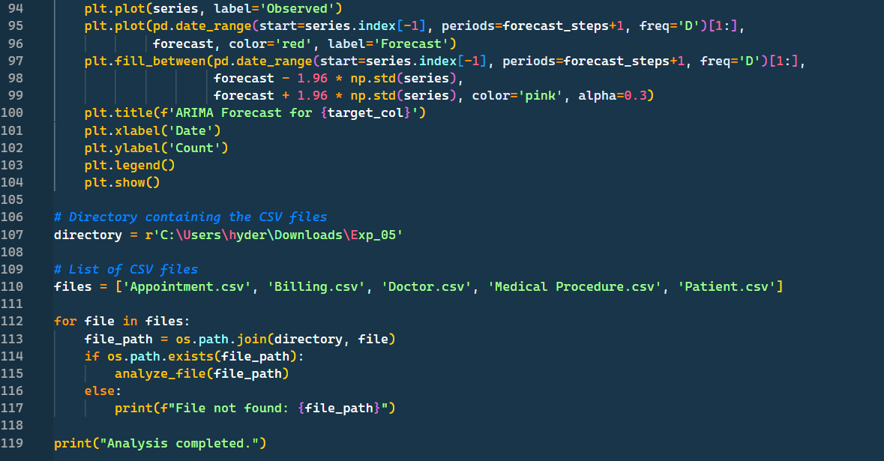
Code

Slide 20
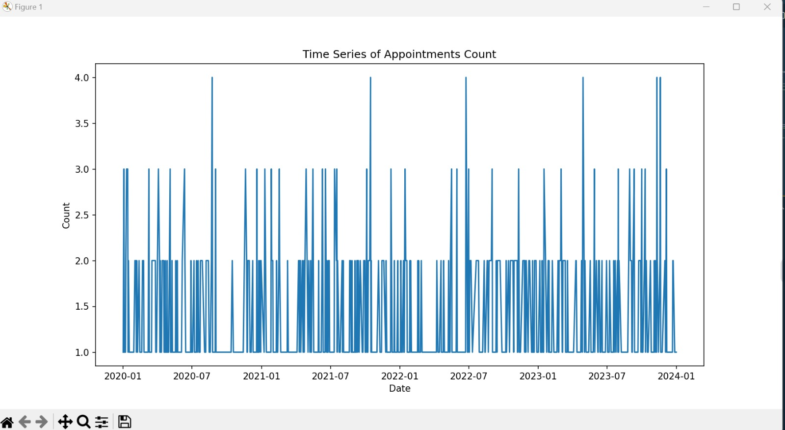
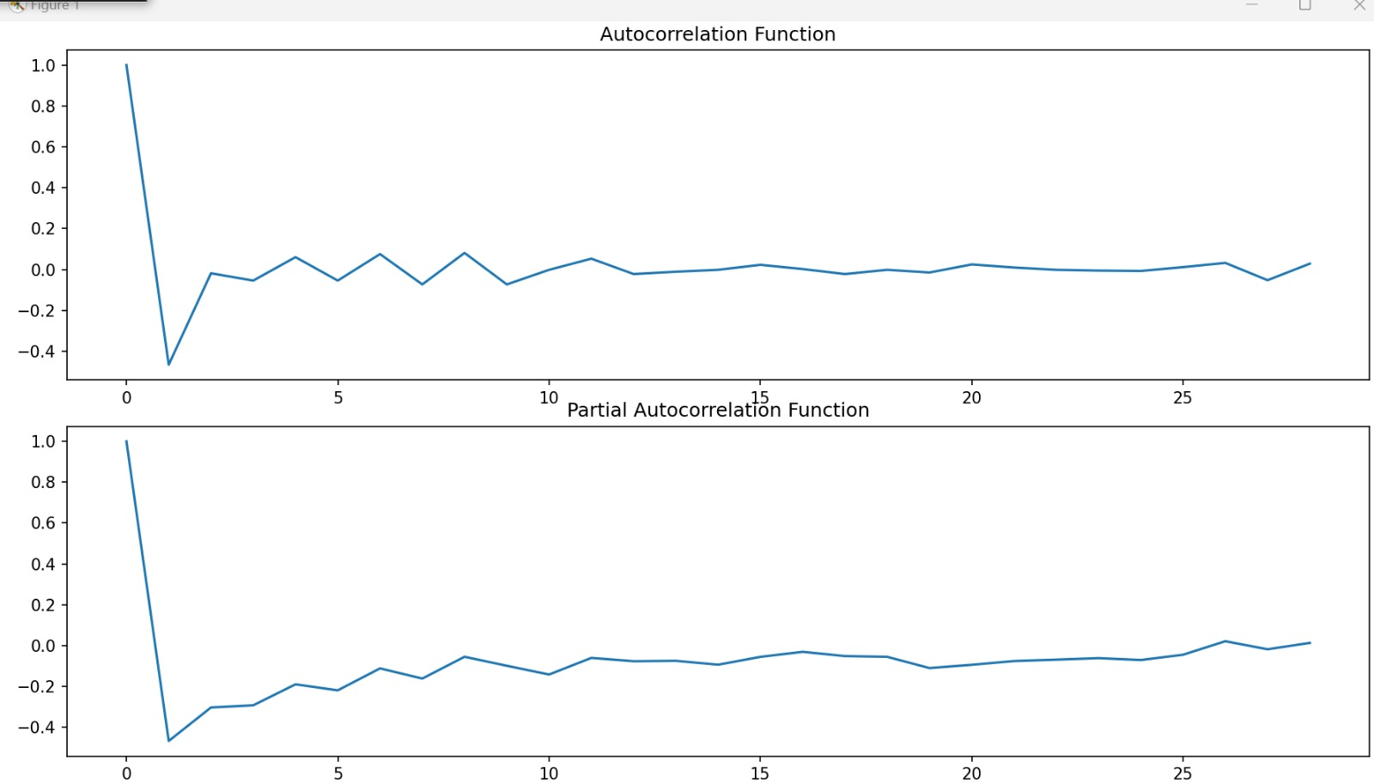

Slide 21
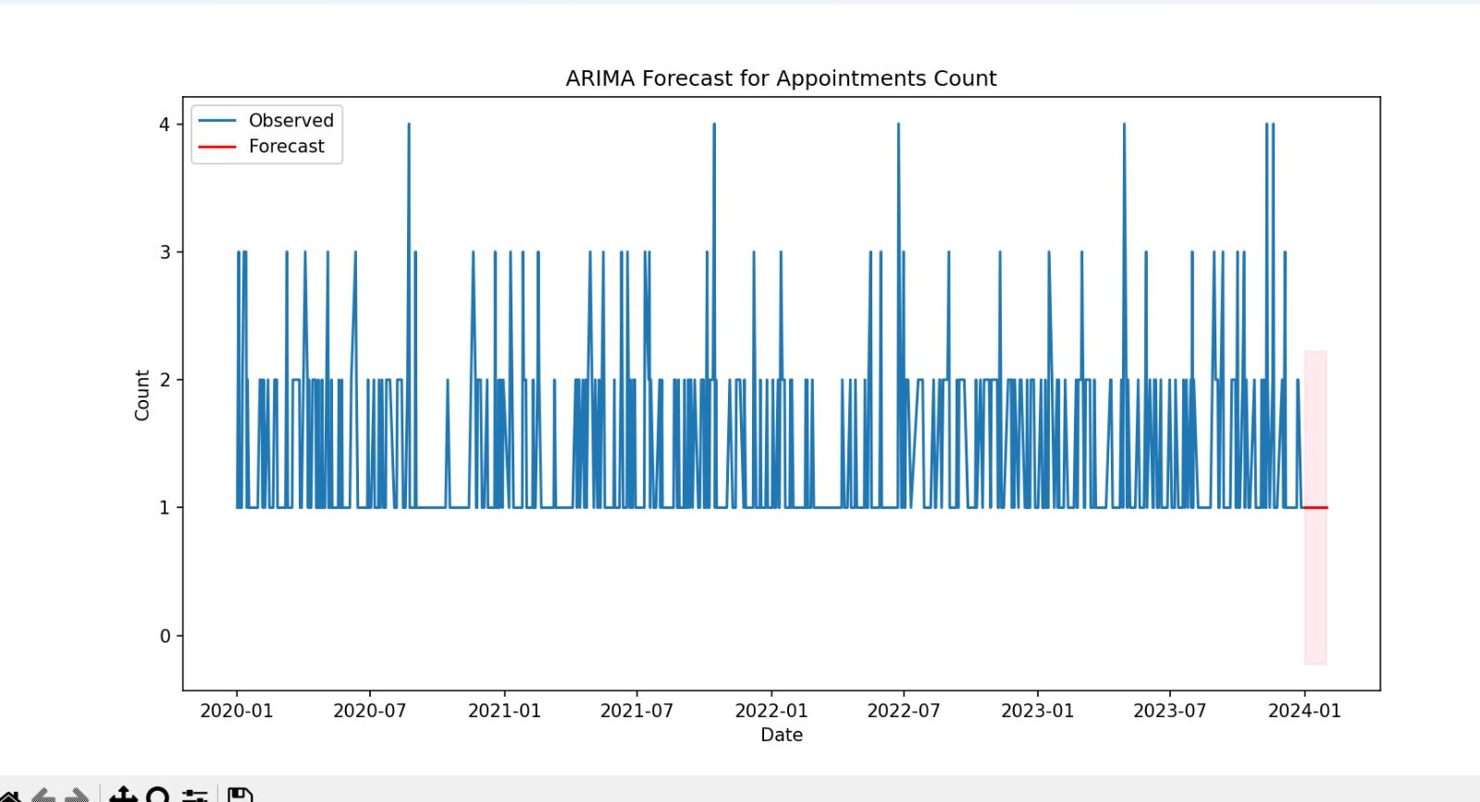

Slide 22
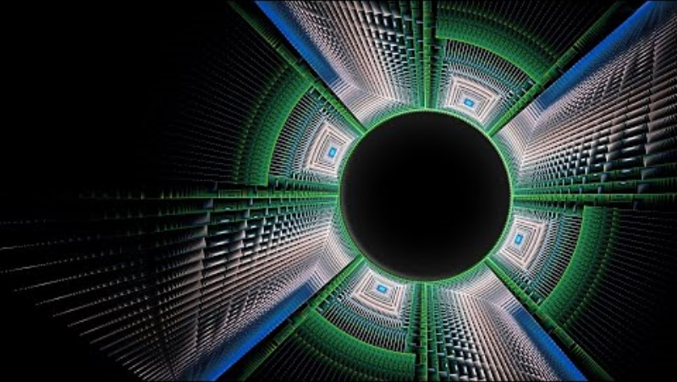
Youtube Video:

Slide 23
THANK YOU

